Slide 1
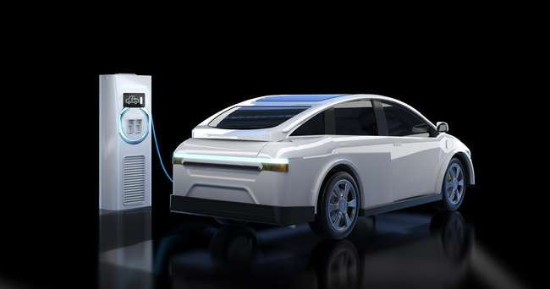




Infosys Internship 5.0
EV FLEET MANAGEMENT
An Intelligent Solution for Electric Vehicle Fleet

Slide 2
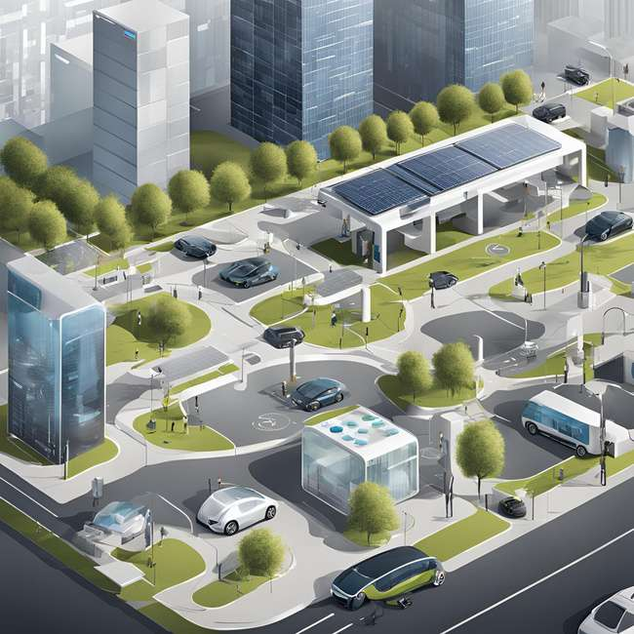

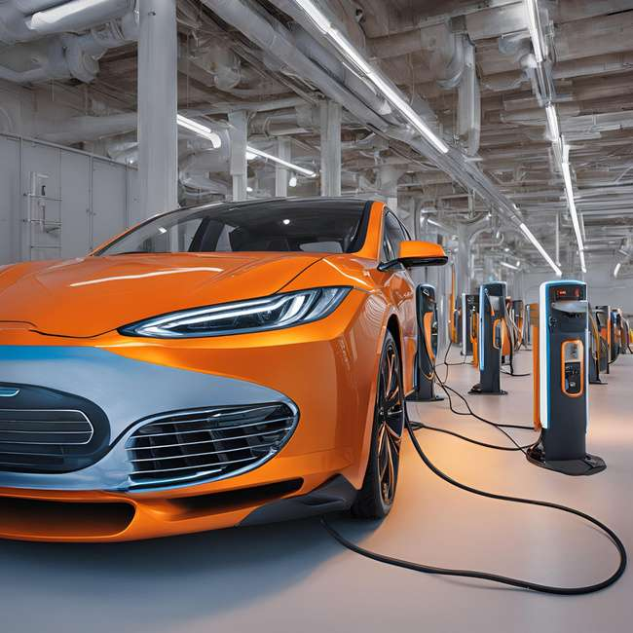
Infosys Internship5.0
INTRODUCTION
The EV Fleet Management solution significantly enhances operational efficiency by providing real-time monitoring of vehicle performance, battery health, and charging status. It helps fleet managers reduce operational costs through optimized routes and proactive vehicle maintenance, ensuring minimal downtime. With features like driver behavior analysis and maintenance alerts, it ensures improved safety and energy efficiency. Additionally, the system generates detailed, customizable reports, offering valuable insights into energy consumption and cost analysis, enabling data-driven decision-making for better fleet management.

Slide 3
Infosys Internship 5.0
Build a comprehensive application for electric vehicle (EV) fleet management to help fleet managers efficiently monitor and manage their EVs.
Objectives:
Track real-time vehicle performance, battery health, and charging status.
Optimize fleet operations with route suggestions and cost analysis.
Provide actionable insights through driver behavior analysis and maintenance alerts.
KEY
CONCEPTS

Slide 4

WEEK-WISE
Infosys Internship 5.0
MILESTONE IMPLEMENTATION PLAN
Project Timeline
Weeks 1-3:
Features: User authentication, role-based access, EV registration.
Output: Registration and monitoring interface.
Weeks 4-5:
Features: Route optimization, battery health alerts.
Output: Route and battery monitoring features.
Weeks 6-7:
Features: Cost analysis and driver behavior insights.
Output: Cost analysis interface.
Weeks 8-10:
Features: ML model integration and report generation.
Output: Deployment and report samples.

Slide 5

Infosys Internship 5.0
PROGRAMMING
LANGUAGES
Backend:
Developed using the Flask web framework with SQL Alchemy ORM and SQLite database for efficient data management.
Incorporates Machine Learning components using scikit-learn for predictive analytics and battery health forecasting.
Frontend:
Built with HTML and CSS, featuring interactive dashboards and real-time data visualization.
Ensures a responsive design for seamless usability
across different devices and screen sizes.

Slide 6


Infosys Internship 5.0
ARCHITECTURE AND DESIGN
Modules:
User Interface: Provides registration, monitoring, and report generation features.
Admin Interface: Enables management of users, fleet details, and system configurations.
Data Acquisition: Collects real-time vehicle data, such as battery status and location, via APIs.
Predictive Analytics: Integrates machine learning models for forecasting and cost predictions.
Visualization: Delivers interactive dashboards and real-time data visualization for enhanced decision-making.

Slide 7

Infosys Internship 5.0
DATA AND
GRAPHS
Data Sources:
Real-time vehicle performance data (battery, speed, location)
Driver behavior logs (acceleration, braking)
Charging station data
Example Graphs:
Battery health trends
Energy consumption over time
Cost vs. efficiency visualization

Slide 8


Infosys Internship 5.0
SECURITY CONSIDERATIONS
Measures Taken:
Authentication: Secure login with email verification and role-based access.
Data Protection: Encrypt sensitive data.
API Security: Secure endpoints with authentication and rate-limiting.
Threat Prevention: Regular monitoring to prevent unauthorized access.

Slide 9
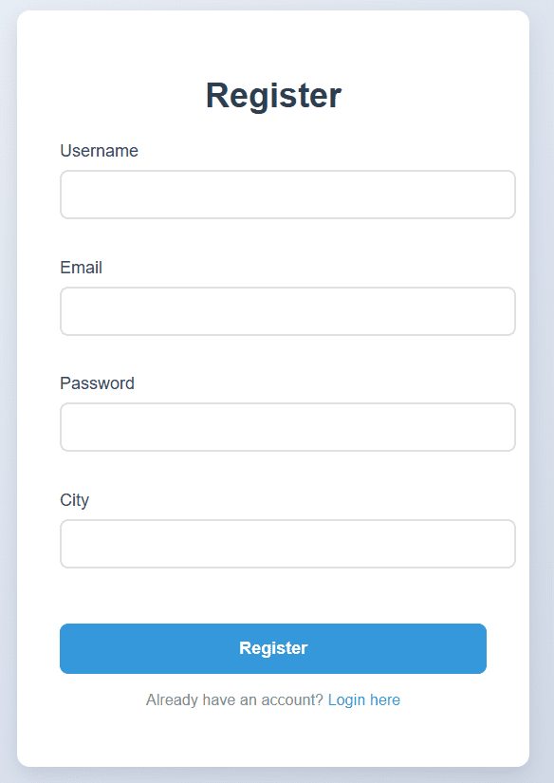
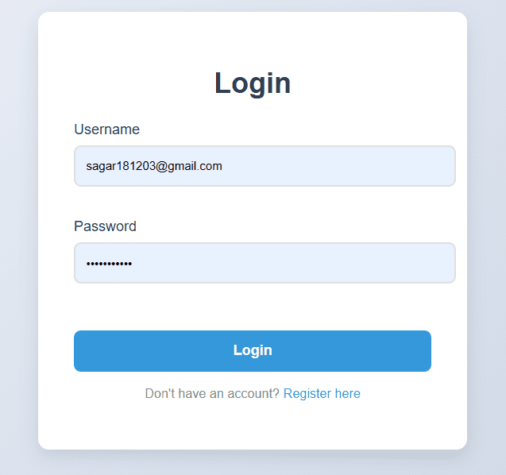
Login & Register Page

Slide 10
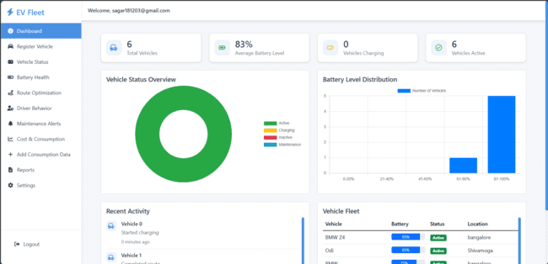
Dashboard

Slide 11
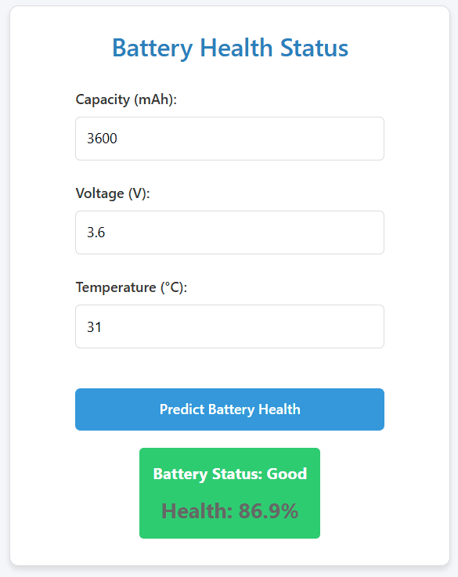
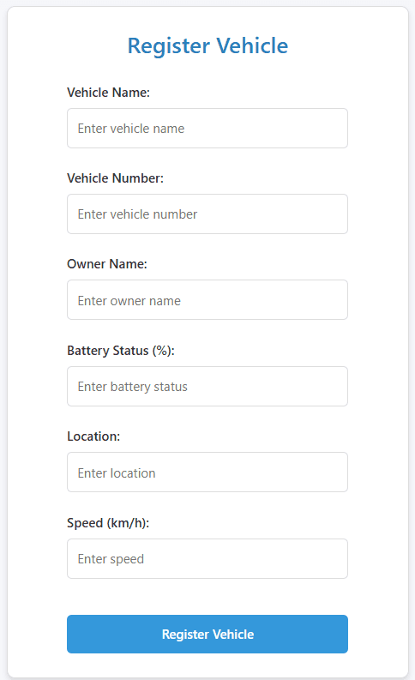
Register Vehicle
Battery Health
Status

Slide 12
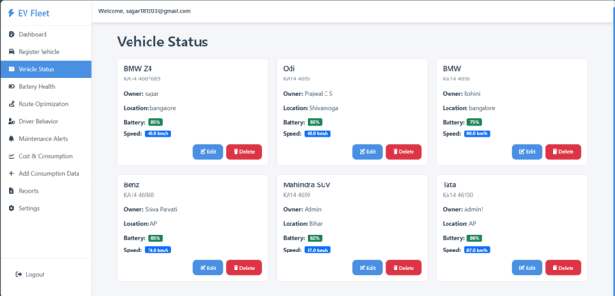
Vehicle Status

Slide 13
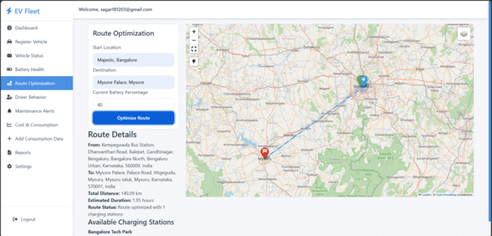
Route Optimization

Slide 14
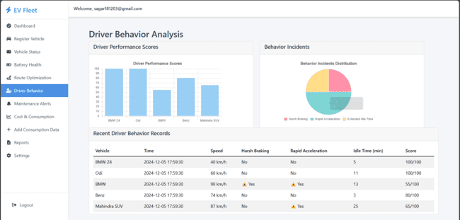
Driver Behavior Analysis

Slide 15
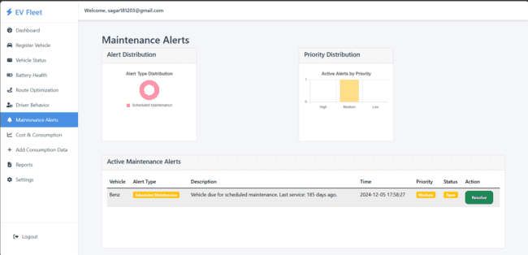
Maintenance Alerts

Slide 16
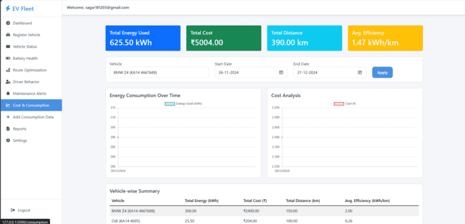
Cost & Consumption

Slide 17
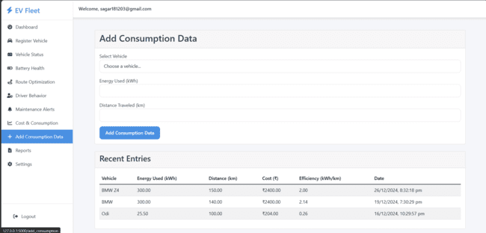
Add Consumption Data

Slide 18
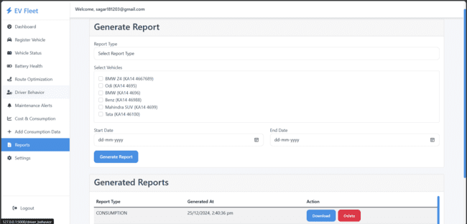
Report Generation

Slide 19
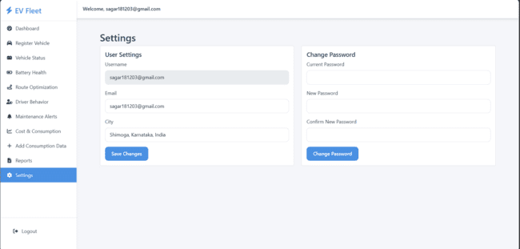
Settings

Slide 20
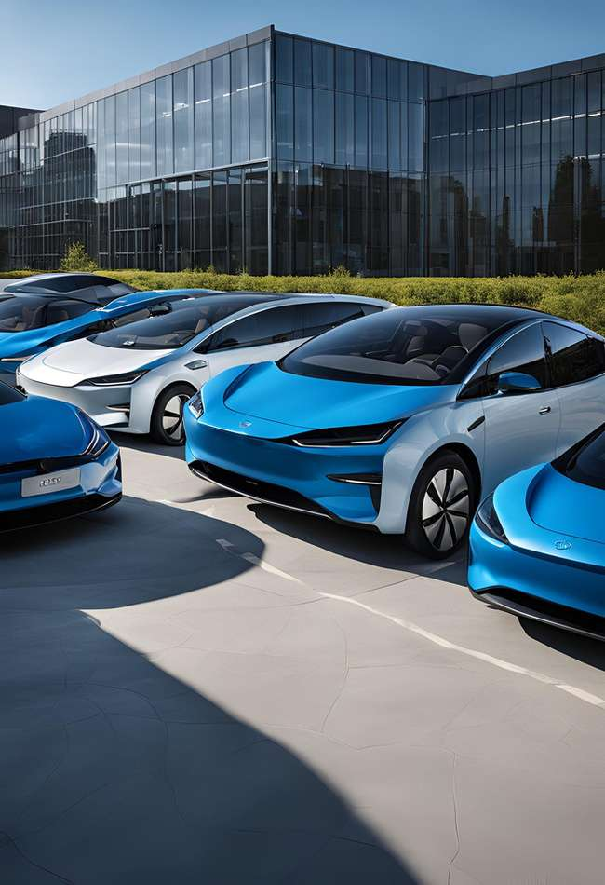
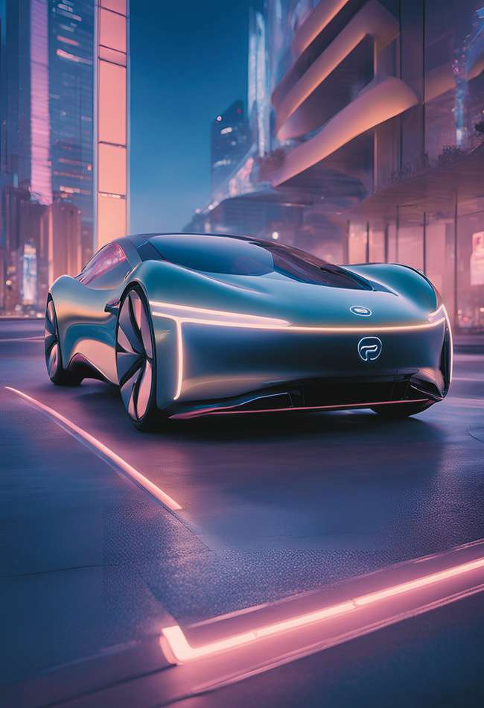
Infosys Internship 5.0
FUTURE TRENDS
The future of EV fleet management lies in integrating Internet of Things (IoT) technology to collect detailed data directly from EV sensors, enabling more accurate monitoring and diagnostics. Artificial Intelligence (AI) will play a critical role in enhancing predictive analytics through advanced machine learning models, further optimizing fleet performance. Blockchain technology is expected to ensure secure and transparent transactions within the fleet ecosystem. Additionally, the expansion of the EV ecosystem will focus on seamless integration with advanced charging networks, driving efficiency and sustainability.

Slide 21
Infosys Internship 5.0
THANK YOU!
Presented By
Sagar Kumar
Sanampudi Siva Parvathi
Rohini Aturi

